Slide 1
Individual Employment Plan (IEP) – WIOA Adult/DW
WIOA TITLE I TRAINING VIDEO SERIES – march 2021
Notes:
Welcome back to the WIOA Title I Training Video Series

Slide 2
WIOA Title I Training Series
Clarifying Expectations and Key Takeaways
Individual Employment Plan
Measurable Skill Gains
Work Experience
Exit
Individual Service Strategies
Credential Attainment
Follow-up Services (Youth)
Notes:
This training focuses specifically on the development and use of Individual Employment Plans. An IEP is the first step in individualizing career services for a jobseeker.

Slide 3
IEP: A Roadmap for Adult/Dislocated Worker Participants
The Individual Employment Plan (IEP) offers an ongoing strategy to identify employment goals and achievement objectives, develop an appropriate combination of services for the participant to achieve employment goals, and document services and achievement of goals .
Needs and Assets Assessment
Identification of Goals and Objectives
Development of a Service Plan
Achievement of Employment Goals
Notes:
An IEP offers a process and tool for working with individuals to identify specific employment goals and objectives and develop plans to achieve those employment goals. An IEP starts with the assessment of an individual’s needs and assets, includes the identification of goals and objectives, the development of a service plan, and ultimately the documentation and achievement of employment goals.

Slide 4
https://www.nj.gov/labor/wioa/resources/
Notes:
You can find New Jersey’s IEP policy in the Workforce Professional Resources section of the NJ WIOA website.

Slide 5
https://www.nj.gov/labor/wioa/resources/
Notes:
All policies that have been issued by NJDOL are available in the NJ Workforce Innovation Notices section.

Slide 6
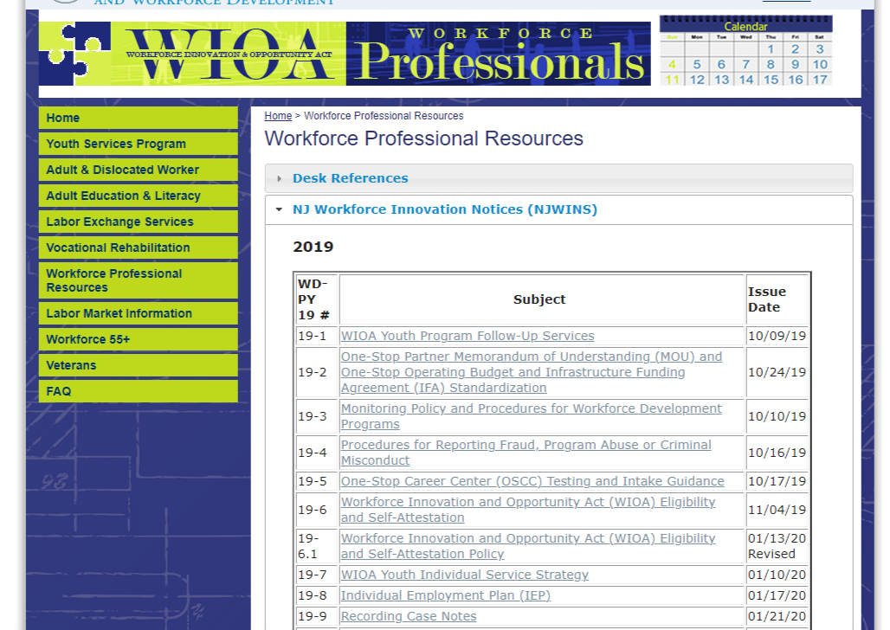
https://www.nj.gov/labor/wioa/resources/
Notes:
Including specifically the IEP policy, WD-PY19-8. It is important to note that this video includes some updates since this IEP policy was developed and offers a higher standard for AOSOS entry that we believe is more reflective of a quality IEP.

Slide 7
Plan Components
IEP Core Elements
Needs Assessment
Short- and Long-Term Employment Goals
Barriers to Employment
Combination of Services
Notes:
This policy highlights four core elements that should be part of an IEP.

Slide 8
Plan Components
Plan Development and Use
IEP Core Elements
Needs Assessment
Short- and Long-Term Employment Goals
Barriers to Employment
Combination of Services
Additional Requirements
An IEP is the foundational tool for engaging participants in individualized career services and case management.
An IEP should be jointly development in partnership with the participant.
An IEP should reflect the unique goals and needs of an individual participant.
An IEP should be used in an ongoing process to monitor and re-evaluate progress towards goals.
An IEP should be used to document strategies and activities as they occur, including documentation of referrals.
An IEP should ground a connected and seamless experience for customers.
Notes:
In addition, this policy lays out specific expectations about plan development and use. We’ll spend the rest of this training video diving into more details around these core areas.

Slide 9
Assessment of Need
Interview and Ongoing Case Management with Participant
Individual Assessment Tools:
Academic
Career Interest
Support Needs
Documentation and Review of Work History
Skills Obtained
Skill Gaps
Notes:
The development of an IEP starts with the assessment of a participant’s needs and interests. This should include an interview and ongoing case management with the participant; the use of specific assessment tools that explore academic skills, career interests, and support needs, as well as a review of work history and skills obtained and needed.

Slide 10
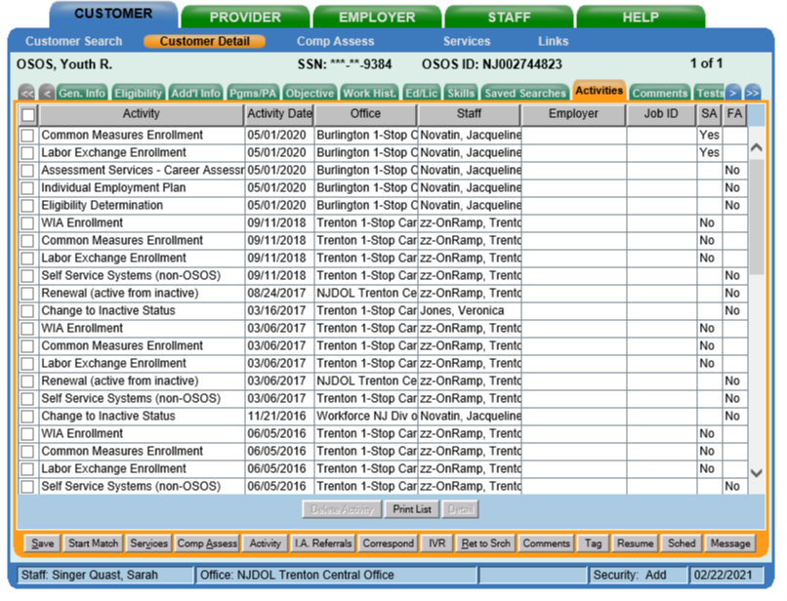
AOSOS Roadmap
Assessment of Need → Customer Detail and Comp Assess
Step 1: All assessment activities should be captured in the Activities tab in Customer Detail
Notes:
Assessments should be documented in AOSOS. Assessment activities must be entered in the Activities tab in customer detail. In addition, prior assessment information that may have been entered as part of prior service with a participant should be reviewed in the development of an IEP.

Slide 11
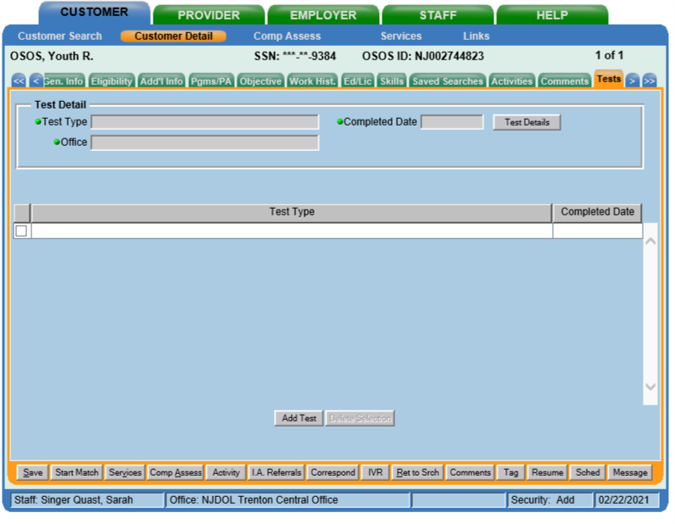
AOSOS Roadmap
Assessment of Need → Customer Detail and Comp Assess
Step 2: Academic test results should be captured in Test tab in Customer Details
Notes:
Academic assessment results, specifically CASAS test results can be captured in the Test tab in Customer Detail

Slide 12
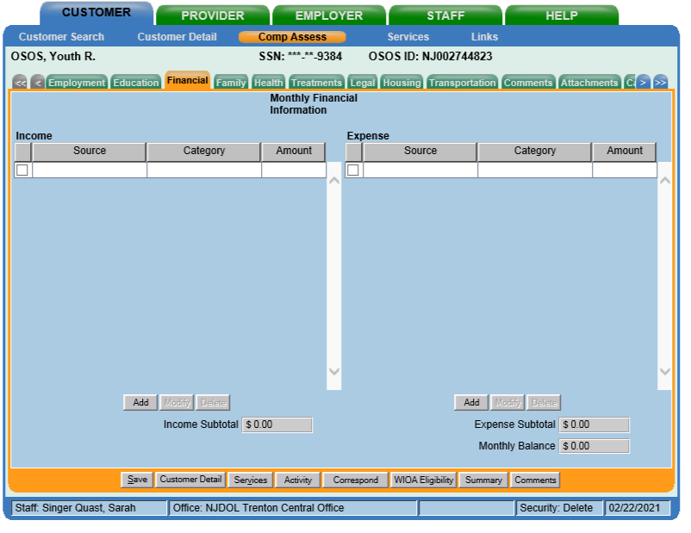
AOSOS Roadmap
Assessment of Need → Customer Detail and Comp Assess
Step 3: Occupational and service need assessment results should be captured across the tabs in Comp Assess
Notes:
Occupational and service need assessment results should be captured across the tabs in Comp Assess

Slide 13
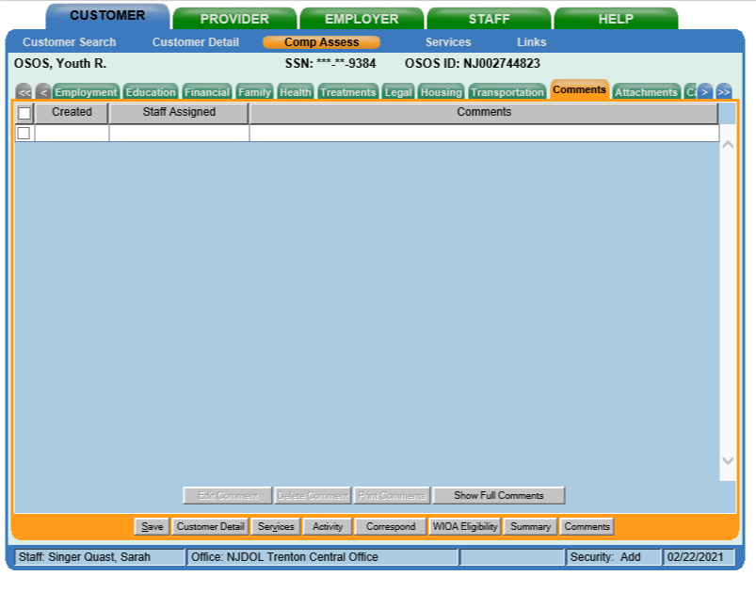
AOSOS Roadmap
Assessment of Need → Customer Detail and Comp Assess
Step 4: Additional documentation of these assessments and their results should be captured in the Comments tab in Comp Assess
Notes:
Additional documentation of these assessments and their results that are not captured in the tabs themselves should be captured as comments in Comp Assess.

Slide 14
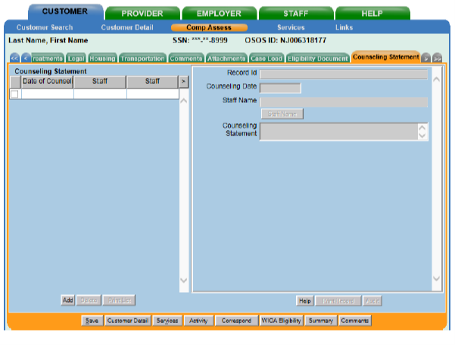
AOSOS Roadmap
Assessment of Need → Customer Detail and Comp Assess
Step 4: Additional documentation of these assessments and their results should be captured in the Comments tab in Comp Assess
Note: Confidential information should be captured in Counseling Statements.
Notes:
However, it is important to note that confidential information should not be highlighted in the comp assess tab but rather as a counseling statement, to protect this confidential information. This screen is only available to individuals in specific counseling roles.

Slide 15
Short- and Long-Term Goals
Achievement Objectives
What are the specific progress points that will indicate the participant is on-track to meeting goals?
(Note: These achievement objectives should demonstrate progress towards goals)
Short-Term Goal
What are short-term goals that the participant hopes to achieve in the near term?
(Note: These short-term goals should align with long-term career goals)
Long-Term Goal
What is the long-term career goal that the participant hopes to achieve?
(Note: This goal will take time and planning to achieve)
Notes:
The second key element of an IEP is the identification of specific short-term and long-term career goals. Long-term goals reflect the ultimate career goal that the participant hopes to achieve. Short-term goals identify goals that the participant hopes to achieve in the near term that align with long-term goals. And achievement objectives are specific actions and activities that participants will achieve that demonstrate progress towards goals.

Slide 16
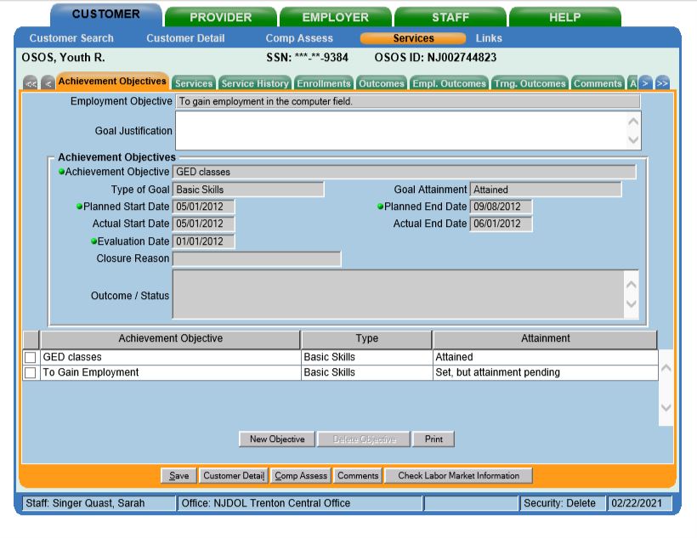
AOSOS Roadmap
Short- and Long-Term Goals→ Services and Comp Assess
Step 1: Document specific details related to goals and achievement objectives:
Achievement Objectives tab in Services
Employment and Education tabs in Comp Assess
Notes:
These goals and objectives should be documented in AOSOS. These specifics can be documented in the Achievement Objectives tab in Services, as well as in the Employment and Education tabs in Comp Assess.

Slide 17
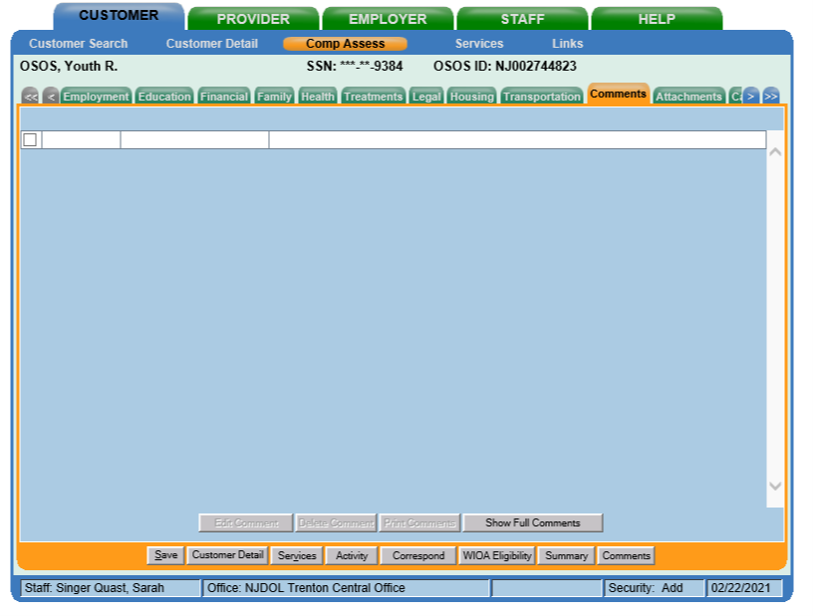
AOSOS Roadmap
Short- and Long-Term Goals→ Services and Comp Assess
Step 2: Document any additional details in the Comments tab in Comp Assess.
Notes:
Any additional details not reflected in these tabs should be included in the comments tab in Comp Assess. And again, during goal setting, prior information that may have been entered before connection to Title I services should be reviewed and reflected in goals.

Slide 18
Barriers to Employment
Skills Gaps: Academic, occupational, and other work readiness skills
Personal Life Circumstances: Life situations that pose barriers to engagement in employment
Technology: Lack of technology; digital literacy needs
Notes:
A third critical element of an IEP and in the IEP process is the specific identification and elevation of barriers to employment that services need to address.
This includes identification of specific skills gaps, as well as personal circumstances such as the need for childcare or transportation, and technology needs, which have become more important with the acceleration to virtual environments and services that occurred because of Covid.

Slide 19
AOSOS Roadmap
Barriers to Employment → Comp Assess
Step 1: Barriers should be captured across the tabs in Comp Assess
Notes:
Barriers to employment should also be documented in AOSOS, and include any prior information about barriers that is already documented through previous engagement with the customer. Barriers to employment should be captured across the tabs in Comp Assess

Slide 20
AOSOS Roadmap
Barriers to Employment → Comp Assess
Step 2: Additional documentation of barriers should be captured in the Comments tab in Comp Assess
Notes:
Additional documentation of barriers that are not captured in the tabs themselves should be captured as comments in Comp Assess

Slide 21
Combination of Services
Core Education/ Employment Service
Supportive Services
Preparation Services
Employment Entry/Advancement
Notes:
The final critical element is the identification and provision of services based on assessment, goal development, and barriers identification.
Services should include core education or employment services that provide entry or advancement in an employment pathway. Services also include any specific preparation services, including training pre-requisites and other readiness supports, as well as, supportive services to help reduce personal barriers.

Slide 22
AOSOS Roadmap
Combination of Services→ Services

Slide 23
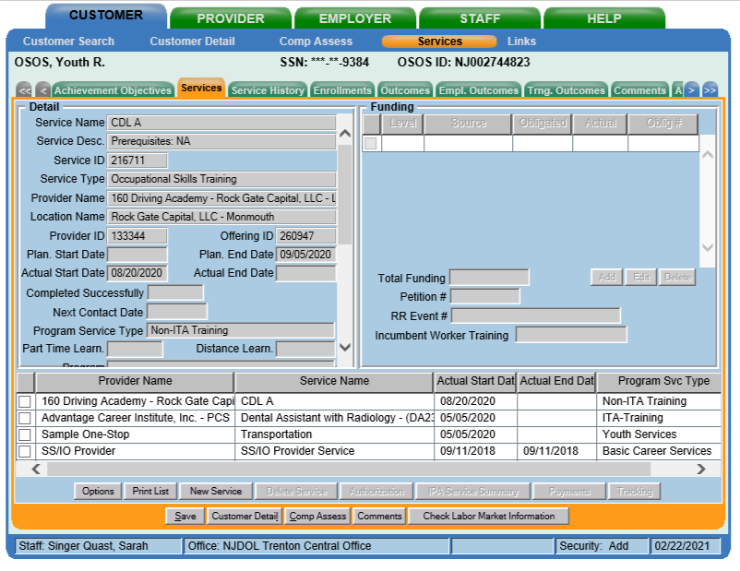
AOSOS Roadmap
Planned and Actual WIOA Services→ Services
Step 1: Designate and fund specific services that align with education, employment, and supportive services a participant is receiving in the Services tab in Services.
Notes:
Services should also be documented in AOSOS. Specifically, training and supportive services should be designated and funded as services in the services tab.

Slide 24
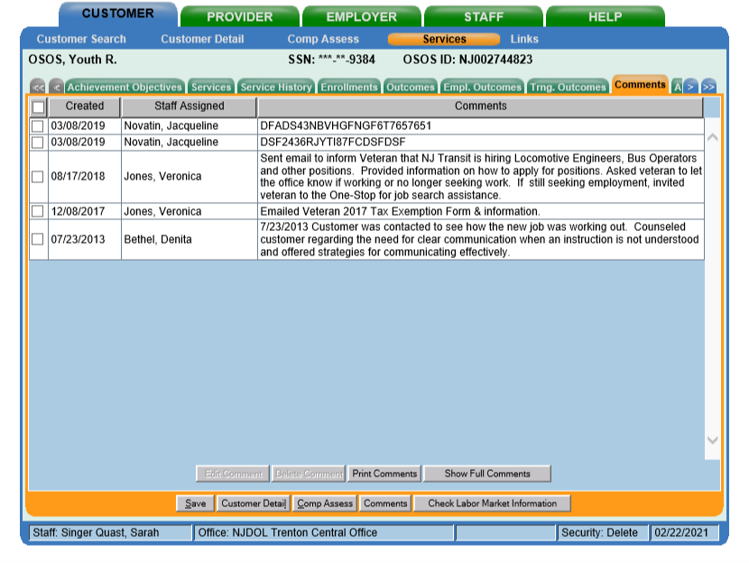
AOSOS Roadmap
Combination of Services → Services
Step 2: Document specific details related to education, employment, and supportive service experiences in the Comments tab in Services.
Notes:
Additional notes and details should be highlighted in the Comments tab in Services. Ultimately, an AOSOS record should offer a clear overview of a participant’s experience.

Slide 25
Plan Components
Plan Development and Use
IEP Core Elements
Needs Assessment
Short- and Long-Term Employment Goals
Barriers to Employment
Combination of Services
Additional Requirements
An IEP is the foundational tool for engaging participants in individualized career services and case management.
An IEP should be jointly development in partnership with the participant.
An IEP should reflect the unique goals and needs of an individual participant.
An IEP should be used in an ongoing process to monitor and re-evaluate progress towards goals.
An IEP should be used to document strategies and activities as they occur, including documentation of referrals.
An IEP should ground a connected and seamless experience for customers.
Notes:
In addition to the components of the IEP, NJDOL’s policy also highlights specific guidance for development and use of the IEP.

Slide 26
Plan Development and Use
An IEP is the foundational tool for engaging participants in individualized career services and case management.
An IEP should be jointly development in partnership with the participant.
An IEP should reflect the unique goals and needs of an individual participant.
An IEP should be used in an ongoing process to monitor and re-evaluate progress towards goals.
An IEP should be used to document strategies and activities as they occur, including documentation of referrals.
An IEP should ground a connected and seamless experience for customers.
Notes:
An IEP offers a foundation for ensuring the individualization of service and support for a participant
An IEP should be developed with the participant
An IEP should reflect individual goals and needs of a participant
An IEP offers a tool and process for ongoing monitoring and evaluation of progress towards goals
An IEP should be used to both document plans and track activities
An IEP should serve as a tool for ensuring that a participant’s experience is connected and seamless – as we’ve mentioned before this includes making connections to prior assessments and IEPs. What information has already been collected and how does this connect to the customers’ current plan?

Slide 27
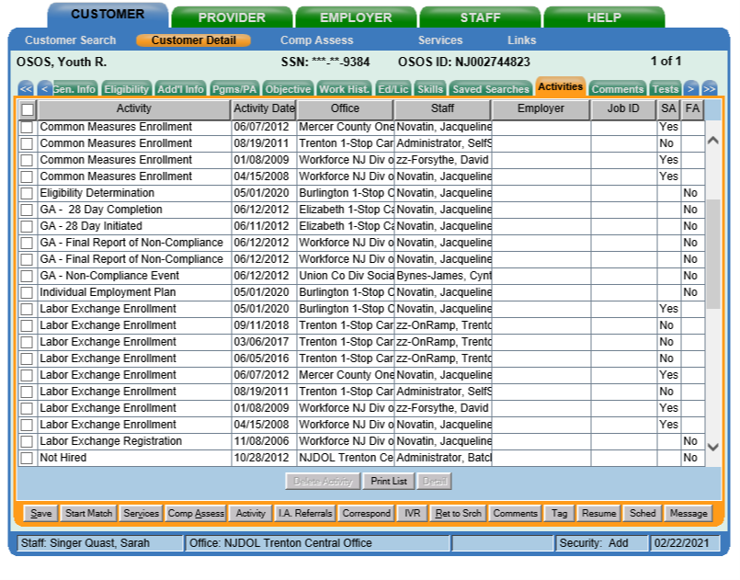
AOSOS Roadmap
Plan Development and Use
Step 1: An IEP activity should be designated every time there is engagement around the IEP in the Activities tab in Customer Detail.
Notes:
A couple last notes about documenting IEPs in AOSOS. Every time there is engagement around the IEP – at the point of creation and when plans are revisited and updated, an IEP activity should be designated in Customer Detail.

Slide 28
AOSOS Roadmap
Plan Development and Use
Step 2: Details about IEP points of engagement should be documented in Comments in Services.
Notes:
Additionally, details and notes about these points of engagement should be documented in Comments in Services.

Slide 29
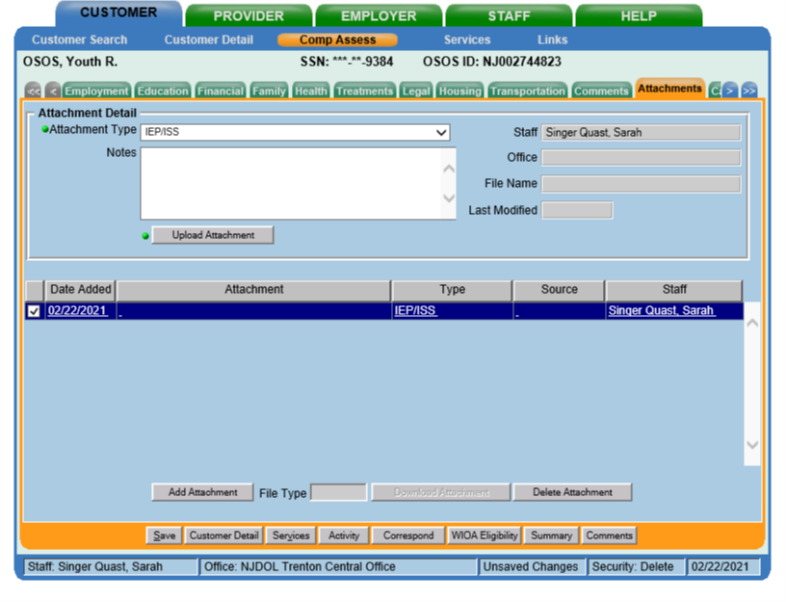
AOSOS Roadmap
Plan Development and Use
Step 3: The paper IEP should be uploaded each time it is updated as an Attachment in the Attachments tab in Comp Assess.
Notes:
Finally, when a new IEP version is complete this should be uploaded in the Attachments tab in Comp Assess. This is a new feature that was added to AOSOS in February 2021 and is available to all AOSOS users.

Slide 30
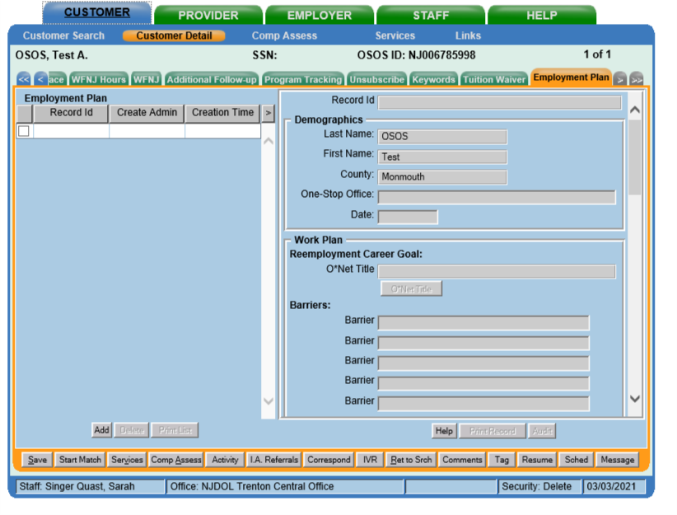
AOSOS Roadmap
Plan Development and Use
Step 4: Elements of the IEP may also be recorded and documented in the Employment Plan tab in Customer Detail
Notes:
Additionally, elements of the IEP may also be recorded in the Employment Plan tab in Customer detail – specifically there are fields for entering barriers, services needed, and information about goals.

Slide 31
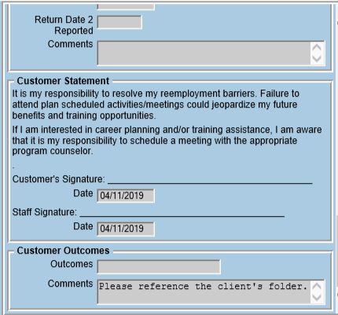
AOSOS Roadmap
Plan Development and Use
Step 4: Elements of the IEP may also be recorded and documented in the Employment Plan tab in Customer Detail
Notes:
While there is not requirement to enter this information here if it is already documented elsewhere, at minimum this tab should include an employment plan entry and date and a comment in the comment field at the bottom of the employment plan that highlights that the IEP is in the attachments or client’s folder.

Slide 32
Additional Resources
NJDOL Policy
NJ Workforce Innovation notices including WD-PY19-8 that outlines specific IEP policy can be found here:
https://www.nj.gov/labor/wioa/resources/
AOSOS Training Videos
Specific tutorials about entering Activities and Comments, the tabs in Customer Detail, and the tabs in Comp Assess can be found here: https://towork.dol.state.nj.us/aosostrainingmaterials/_layouts/15/start.aspx#/
Contact us at Career Services with any questions at WIOApolicy@dol.nj.gov
Notes:
This concludes our summary of the IEP. Additional resources including NJDOL’s policies and a series of training tutorials on AOSOS may help to augment knowledge of concepts highlighted in this training. If you don’t have access to these materials or have any additional questions, don’t hesitate to reach out to us at WIOApolicy@dol.nj.gov

